Slide 1


Mediator

Slide 2
Mediator

Slide 3
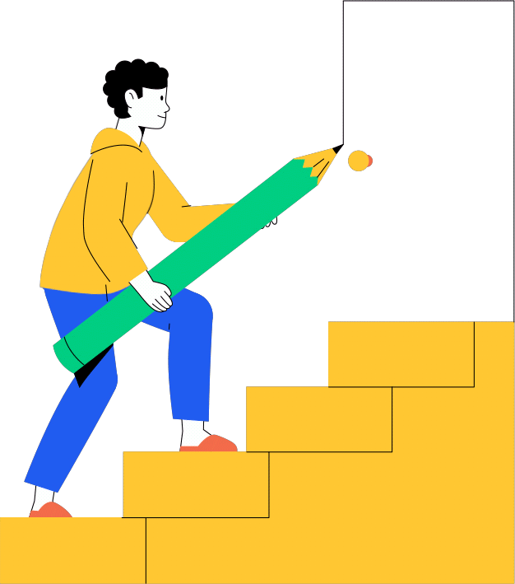
introduction

Slide 4

Brainstorming
To solve a problem facing people
We achieve our course objectives

Slide 5

Abdominal pain

Slide 6

The doctor forgot to ask
Or the patient gives an unclear answer

Slide 7

Mediator

Slide 8

Mediator
An intermediary between
the patient and the doctor
Record the patient's medical history
Medication conflicts

Slide 9

Pneumonia:

Slide 10

Search for
patient data

Slide 11

Conflicting medication

Slide 12

Non-contradictory medication

Slide 13


Diagnosis with
mediator

Slide 14
Collaboration
between Drs

Slide 15
ER Diagram

Slide 16
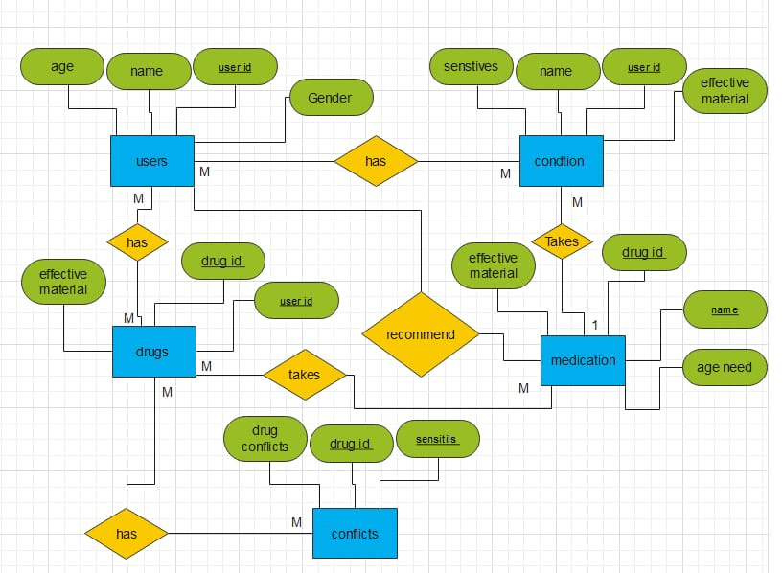

Slide 17
Database

Slide 18
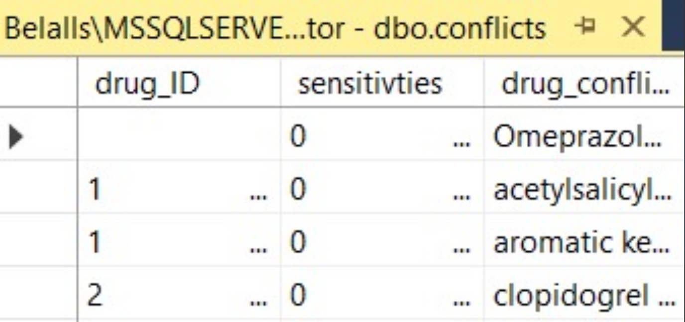
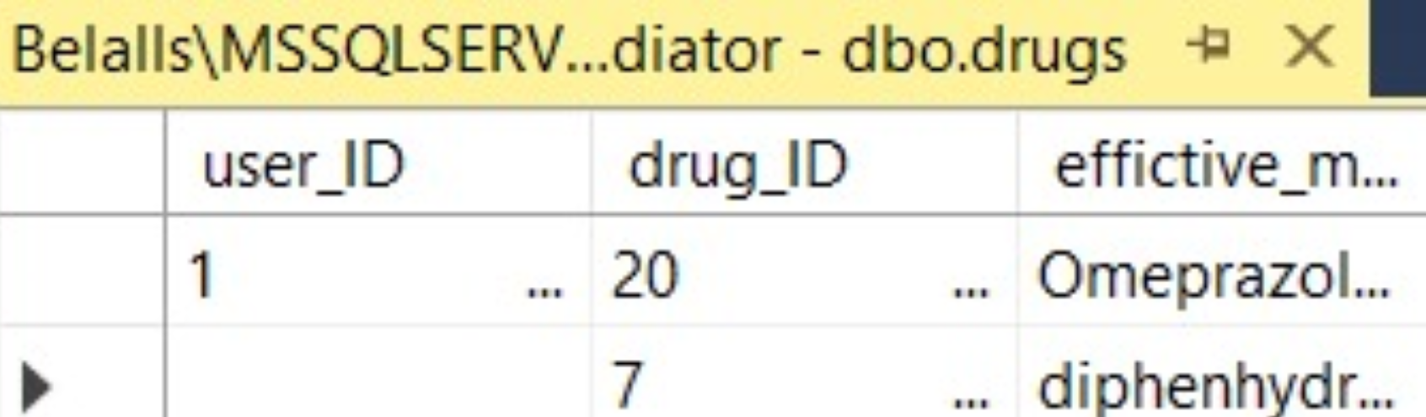

Slide 19
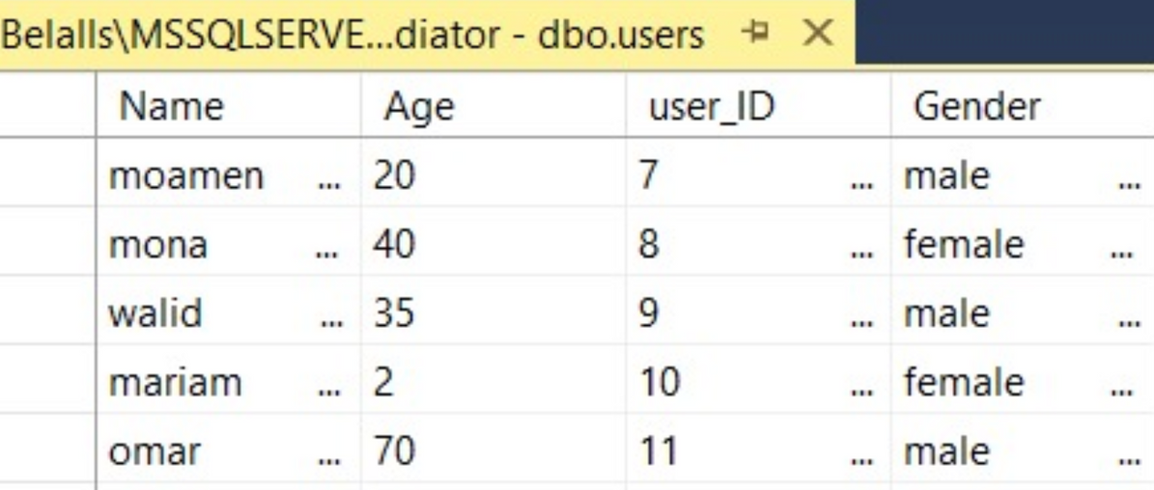
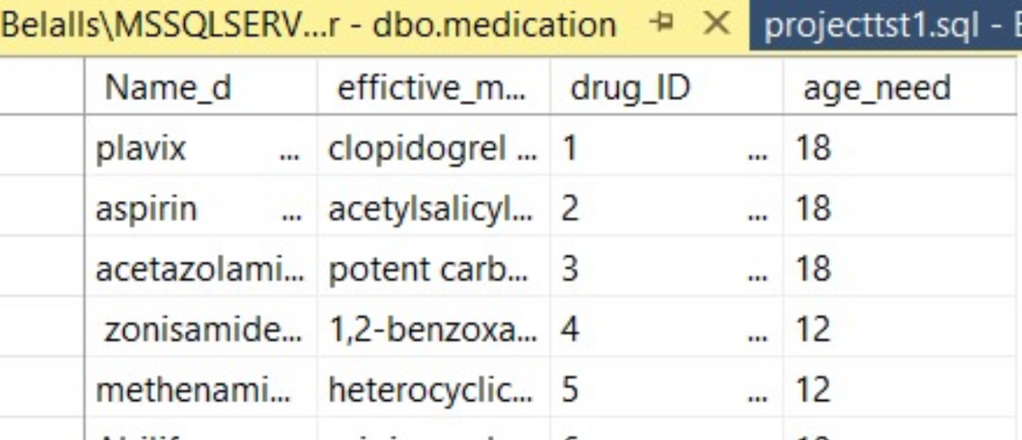
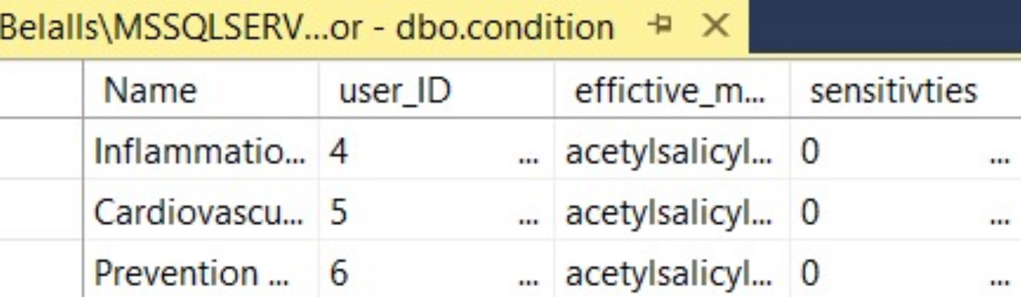

Slide 20
Examples
Examples

Slide 21
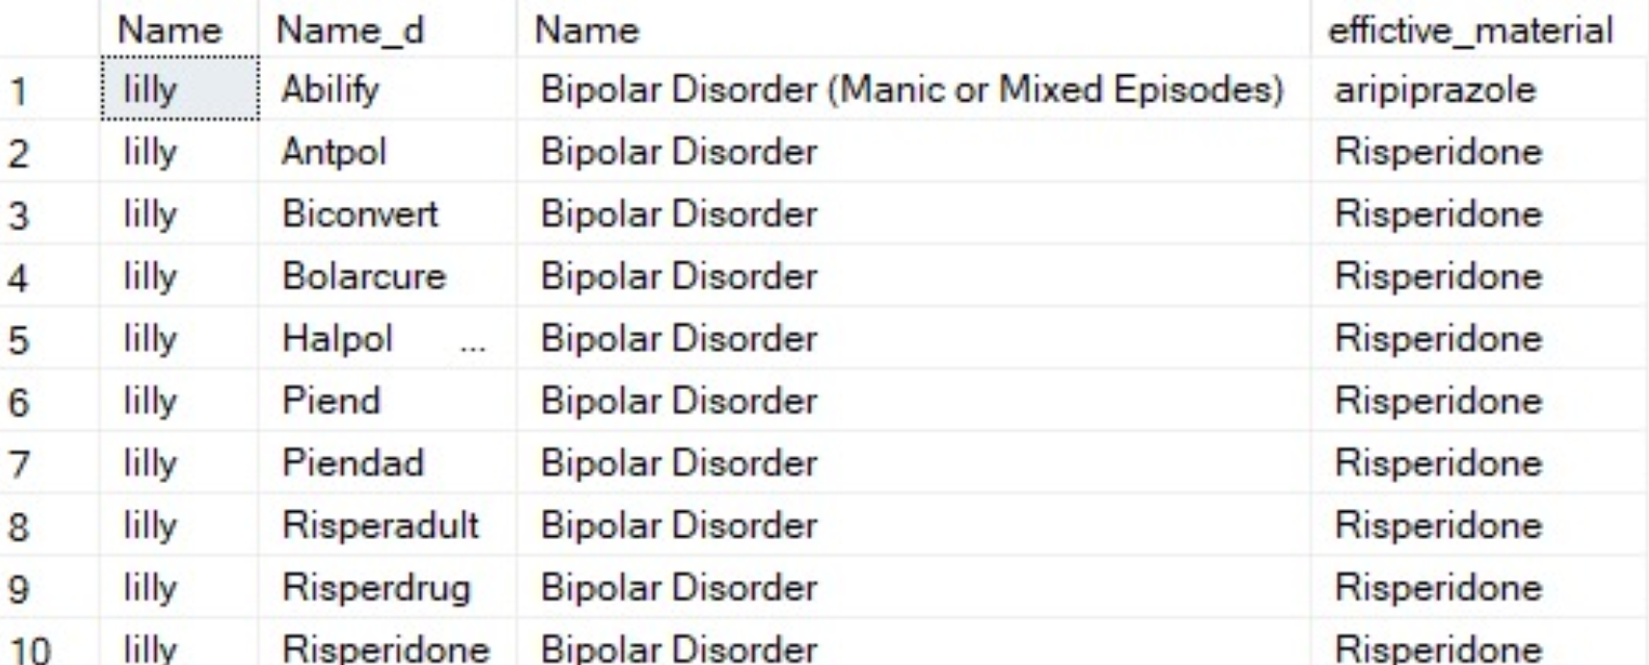

Slide 22
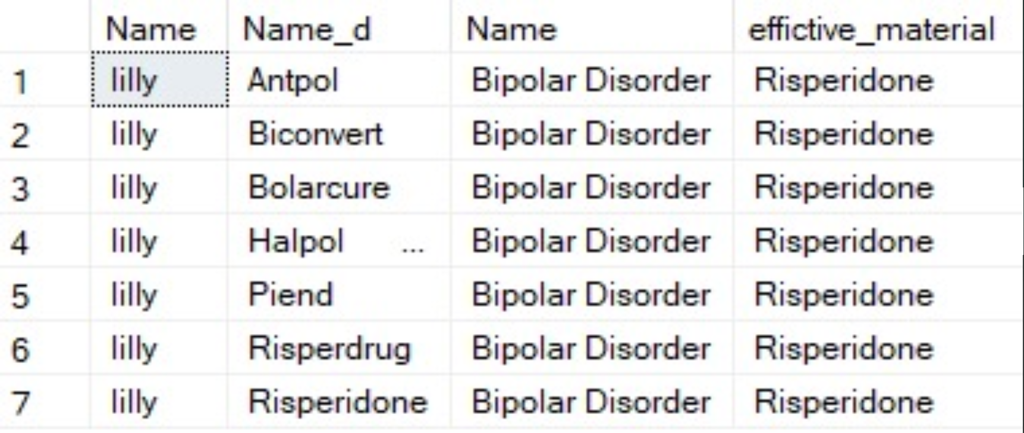

Slide 24
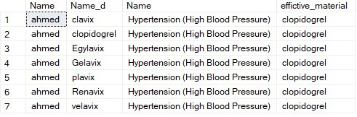

Slide 25
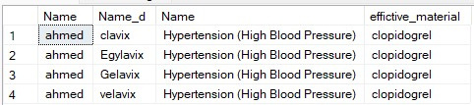

Slide 26
Results and next step

Slide 27
Next step
Results
Make a website
Increasing the data set
for medications
Database work on drug conflicts

Slide 28
Our goal
Giving a life opportunity to someone who could have taken a conflicting medication

Slide 29

Thanks

